Slide 1

CYBV474
Advanced Analytics for Security Operations
Week 4
Identify elements of cyber operations that can benefit from advanced Python Solutions (Part IV)

Slide 2

Agenda
Overview of Cyber Deception
Examining Log Analysis and Extraction
Methods

Slide 3
Read
Review the provided articles
relating to cyber deception
Watch
Watch the weekly videos
Week Four Assignments
Participate in
Participate in this week's live lecture (or watch the replay, if you are unable to attend in person)
Complete
Complete this week's quiz
Complete
Complete this week’s
assignment:
Note: Make sure to Review the grading rubric prior to submission

Slide 4















Introduction to Cyber Deception

Slide 5

Active Cyber Defense Cycle Where does cyber- deception fit in?
Incident
Response
Examining Attack Methods
Identifying Objectives
Gaming the Adversary
Identifying key Characteristics
Assessing the sophistication of the attack and attacker
Determining location of the attacker(s)
Asset Identification
Network Security Monitoring
Threat Identification
and
Manipulation
Integrating decoys,
traps and Lures
Threat Intelligence
Consumption

Slide 6

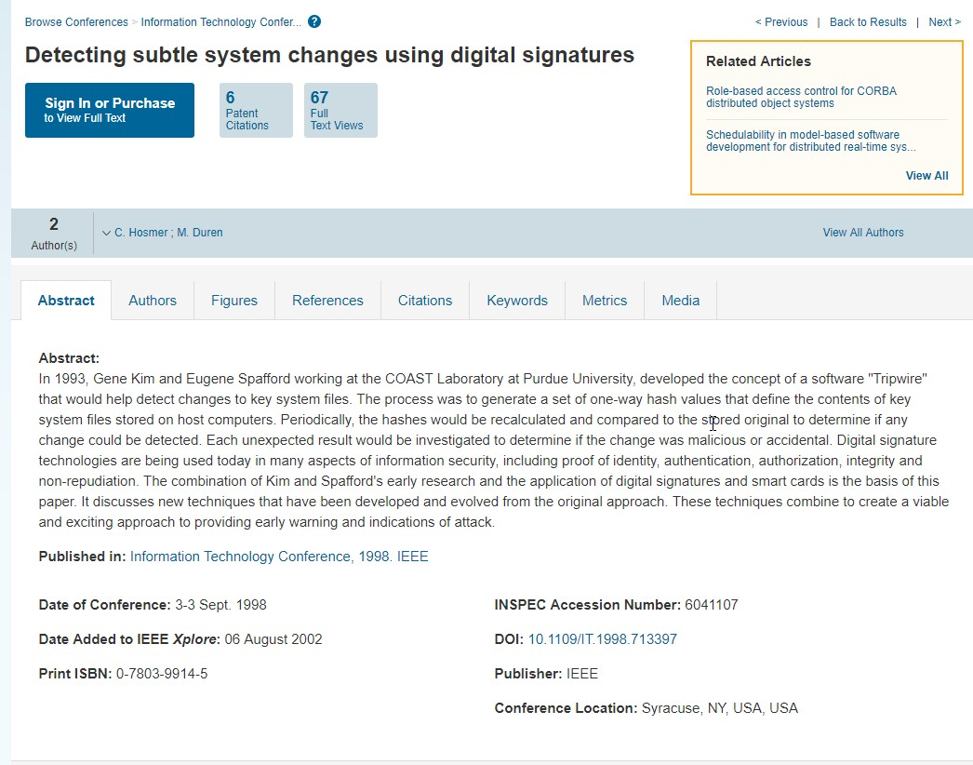

Traps – Tripwires for example

Slide 7






Lures

Slide 8



Decoys

Slide 9

Research Opportunities
Incident
Response
Examining Attack Methods
Identifying Objectives
Gaming the Adversary
Identifying key Characteristics
Assessing the sophistication of the attack and attacker
Determining location of the attacker(s)
Asset Identification
Threat Identification
and Manipulation
Network Security Monitoring
Integrating decoys, traps and Lures
Threat Intelligence
Consumption

Slide 10
Log Analysis

Slide 11
PowerShell
Live Demonstration

Slide 12



PowerShell Extracting and Examining Windows Event Logs

Slide 13
Extracting actionable evidence from system, security and application event logs
EVENT LOGS

Slide 14






Get-EventLog CmdLet

Slide 15

A few simple examples to get you started
PS | C:\PS> | get-eventlog | system -Newest 20
PS | C:\PS> | get-eventlog | application -newest | 20
PS | C:\PS> | get-eventlog | security -Newest 20
Note access to this log requires admin privilege on most platforms

Slide 16
Your Challenge
Dive into PowerShell
Focusing on the Get-EventLog Cmdlet

Slide 17
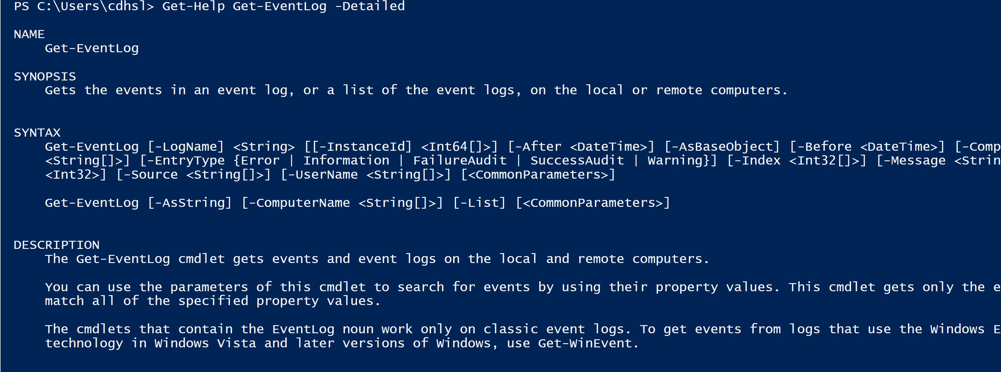
Become familiar with PowerShell (specifically the CmdLet Get-EventLog). A great place to start is using the Get-Help CmdLet
First Step

Slide 18
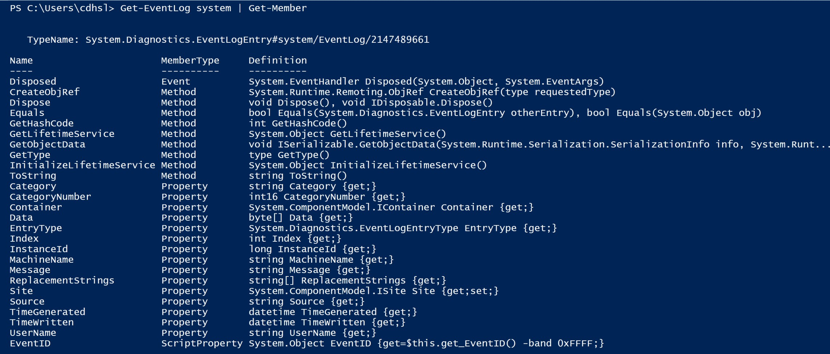

Next Step
Examine the many properties that are available from CmdLet. You can do this by piping the output of the Get-EventLog CmdLet to Get-Member.

Slide 19
1) Identify key properties from each eventlog (system, application and security) that will provide actionable information.
Final Step
2) Construct PowerShell Command to extract those properties. These will be used later to create Panda DataFrames

Slide 20


Questions?
Coming Up Next Week:
Python Pandas

